Slide 1


Genetic Optimization of Fuzzy C-Means Clustering-Based Fuzzy neural networks
Ha-Rang Kim
25.7.13
ⓒSaebyeol Yu. Saebyeol’s PowerPoint

Slide 2
Table of contents
1
Genetic Optimization of Fuzzy C-Means Clustering-Based Fuzzy Neural Networks

Slide 3
GA of FCM-based FNN
Introduction
Paper propose FCM-FNN(Extended architecture of RBFNN)
Premise part
Consequent part
FCM
Polynomial (LSE)
GA
- Global optimization
- Premature convergence
-> HFCPGA(Hierarchical Fair Competition Parallel Genetic algorithm)
-Population diversification, Hierarchical structuring
Input variable selection
Number of fuzzy space (fuzzy rules, cluster)
Polynomial degree of the consequent part
Fuzzification coefficient

Slide 4



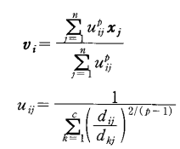
GA of FCM-based FNN
Algorithm – premise part
<In algorithm>
Number of clusters = Number of Fuzzy rules
Degree of membership = Fitness value of each rule

Slide 5
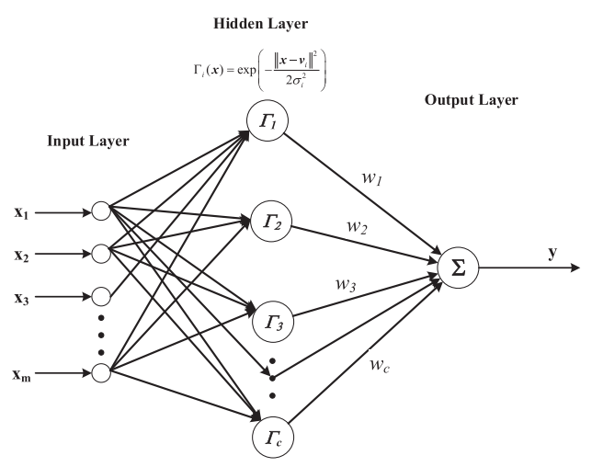
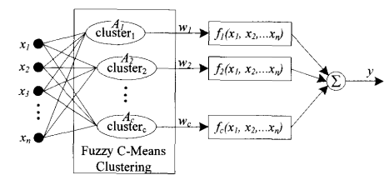


GA of FCM-based FNN
Algorithm
(RBF kernel)
(Membership function)

Slide 6

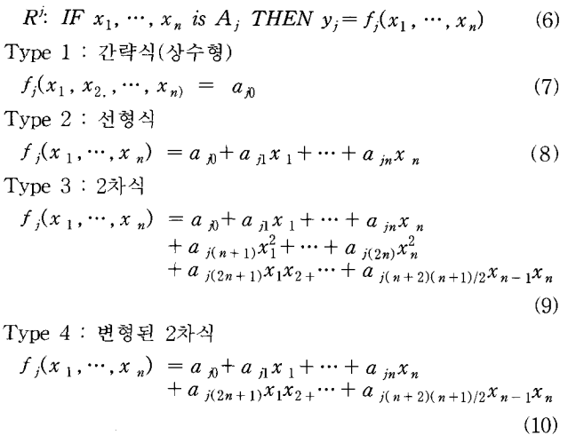
GA of FCM-based FNN
Algorithm – consequent part

Slide 7


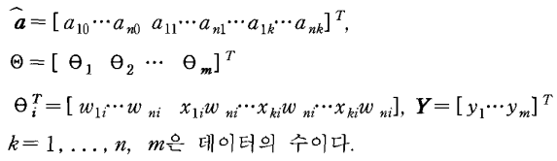
GA of FCM-based FNN
Algorithm – output
(If consequent polynomial is linear)

Slide 8
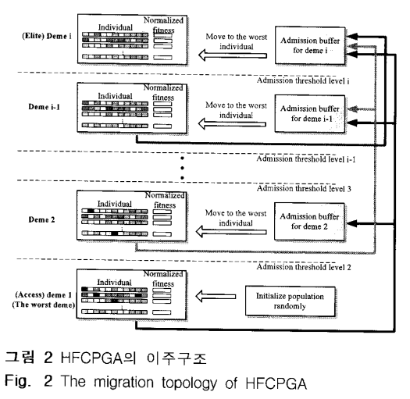
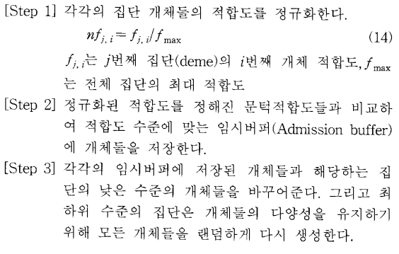
GA of FCM-based FNN
Algorithm – HFCPGA
GA
- Global optimization
- Premature convergence

Slide 9
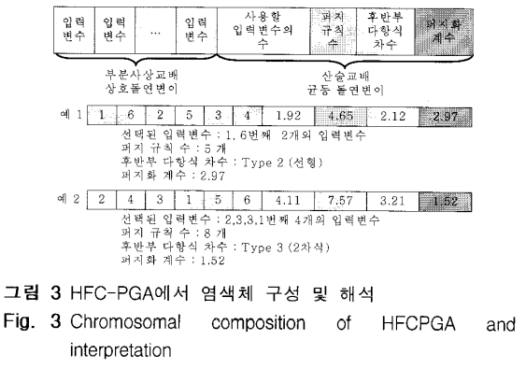




GA of FCM-based FNN
Algorithm – HFCPGA
Symbolic coding
: Sub chromosome (+4)
Floating coding

Slide 10

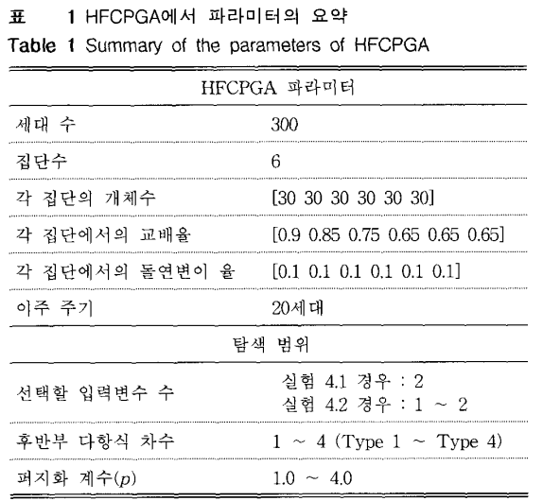
GA of FCM-based FNN
Experiments

Slide 11
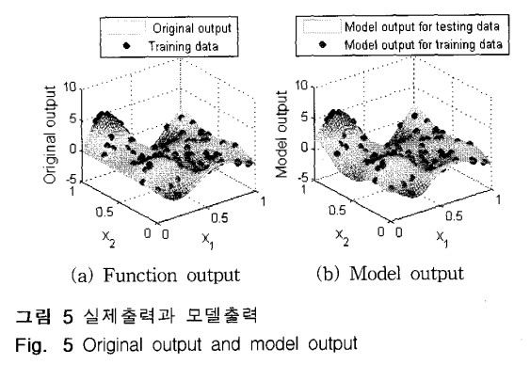
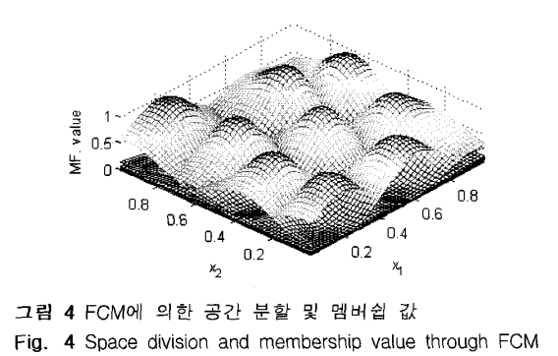
GA of FCM-based FNN
Experiments (4.1)
Data: 100 (random)
Number of rules : 9
Second order polynomial
P : 1.9076
PI : 0.00199
EPI : 0.07158

Slide 12
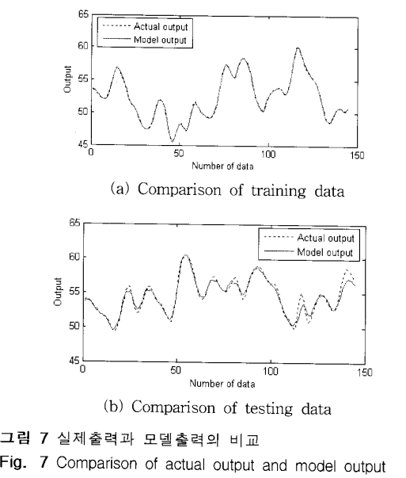
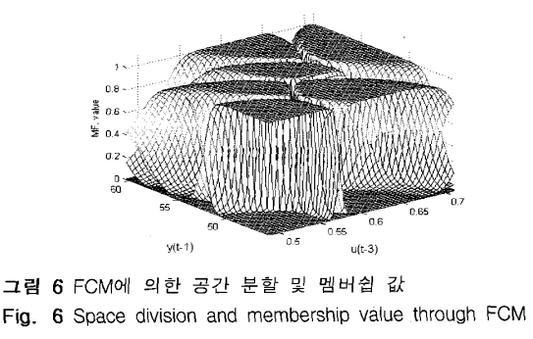
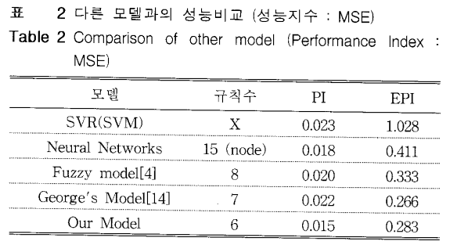
GA of FCM-based FNN
Experiments (4.2- gas furnace)
Data pair : 296 (145)
Number of rules : 6
Second order polynomial
P : 1.098
PI : 0.0149
EPI : 0.283

Slide 13
GA of FCM-based FNN
Conclusion
- FCM is used in the premise part, and various types of polynomials are sued in the
consequent part as local models. (LSE)
- Selecting the optimal value for model construction
- The model actively reflects data characteristics -> Performance improvement

